Slide 1
8086 Microprocessor minimuim /maximuim mode
By: hitesh lad

Slide 2
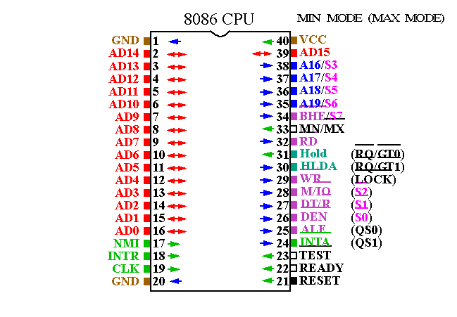
8086 Pin Diagram

Slide 3
THE 8086 MEMORY BANK
UPPER BANK
LOWER BANK
ODD
EVEN
CS
CS
BHE
A1---A19
A0
D15-D8
D7-D0

Slide 4
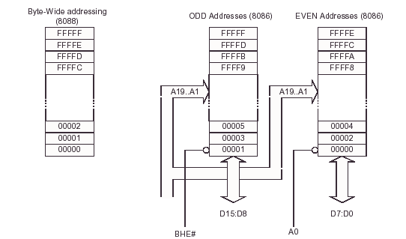

Slide 5
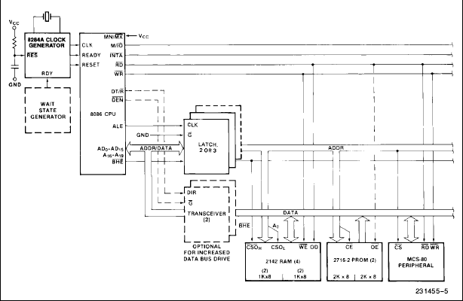
Minimum Mode:

Slide 6
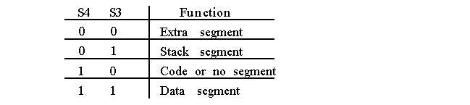
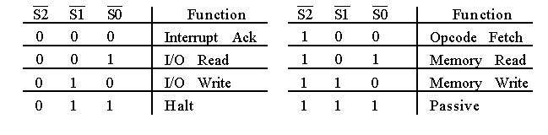
8086 Minimum Mode
S5: Status of IF
S6: 0

Slide 7
8086 Minimum Mode
S5: Status of IF
S6: 0

Slide 8
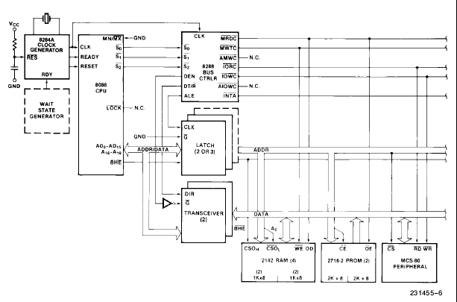
Maximum Mode:

